Slide 1
Impact of Inflation and Unemployment on Economic Growth
Thesis Presentation
Presented by: Muhammad Usman (19U00282)

Slide 2
Introduction
The purpose of this research is to assess the influence that inflation and unemployment would have on Economic Growth.
The growth rate serves as the dependent variable in the economic model, while inflation, unemployment, the exchange rate, the money supply, investment, interest rate and the savings rate served as independent variables.
Unemployment and Inflation are problems at the heart of every country's social and economic life. Existing literature points to inflation and unemployment as twin problems explaining the nature of poverty in developing countries.
Inflation increases the cost of the country and creates more financial problems by increasing the cost of goods and services and other factors (Rasheed et al., 1997).
All economies intend to keep both in the lowest single digits as this creates stability in the country's macroeconomic policies.
This stability is very important for the effective growth and development of the economy and for the achievement of economic policy goals and objectives (Orji et al., 2015).

Slide 3
Literature Review (Historical Literature)
Inflation can have a variety of negative effects on economic growth, including increasing the tax on capital, the opportunity cost of capital, higher interest rates, discouraging exports, discouraging savings, inefficient government spending, tax increases, decreasing purchasing power, increasing uncertainty, and discouraging investment.
Unemployment can also have a negative impact on economic growth, as it leads to a decrease in aggregate demand and a decrease in the overall productivity of the economy.
However, there is some evidence that a small amount of inflation can actually be beneficial for economic growth, as it can lead to increased investment and economic activity.
Ultimately, the relationship between unemployment, inflation, and economic growth is complex and depends on a variety of factors, including the overall state of the economy, the policies of the government, and the behavior of businesses and consumers.

Slide 4
Literature Review (Theoretical Literature)
Phillip’s Curve (1958)
Phillips created the piece of work that is often referred to as "the Phillips curve" in 1958.
The Phillips curve depicts the typical link between pay behavior and unemployment rates over the economic cycle.
He found a short-term trade-off among inflation and unemployment. Therefore, he proposed the hypothesis that increasing inflation might be caused by dropping unemployment and that decreasing inflation could be achieved by enabling unemployment to grow.
Okun’s Law (1962)
States that a 1% drop in the rate of employment would lead to a loss of roughly 3% GDP.
If the causation were reversed, a 1% rise in unemployment would result in a loss of GDP growth of around 3%.

Slide 5
Literature Review (Theoretical Literature)
The General Theory of Employment, Interest, and Money, written by John Maynard Keynes (1936)
This theory laid the groundwork for Keynesian economics.
Keynesians believe that for efficiency to be at its highest, government intervention is required.
They believe that governmental intervention in the market via expansionary economic policies will spur demand and boost investment, enabling full production.
Quantity theory of Money (1956)
Milton Friedman
Quantity Theory of Money linked inflation and economic growth by simply matching the entire amount of economic spending to the total amount of money in circulation.
Monetary theory argues that money expansion has a longer-term, more significant effect on pricing than it does on growth. If the money supply is growing more quickly than the economy, inflation will happen.

Slide 6
Literature Review (Empirical Literature)
Inflation can have a number of negative effects on economic growth, including:
It can reduce the purchasing power of consumers, which can lead to a decrease in demand.
It can make it more difficult for businesses to plan for the future, which can lead to a decrease in investment.
It can lead to higher interest rates, which can also discourage investment.
It can lead to uncertainty in the economy, which can make it more difficult for businesses to operate and for consumers to make decisions.
Unemployment can also have a number of negative effects on economic growth, including:
It can reduce the output of the economy, as unemployed workers are not producing goods and services.
It can lead to a decrease in demand, as unemployed workers have less money to spend.
It can lead to a decrease in investment, as businesses may be less willing to invest if there is a large number of unemployed workers.
It can lead to social problems, such as crime and poverty.

Slide 7
Model-Equation-Hypothesis
Y_{it} = β₀ + β₁ Infl_{it} + β₂ Unemp_{it} + β₃ ER_{it} + β₄ MS_{it} + β₅ Inv_{it} + β₆ Sav_{it}+ β₇ IR_{it} + µ_{it}
Null Hypothesis
H₀ : β₁ = 0 H₀ : β₂ = 0
Impact of Inflation on Economic Growth is insignificant, β₁ equal to 0.
Impact of Unemployment on Economic Growth is insignificant, β₂ equal to 0.
Alternate Hypothesis
H₁ : β₁ ≠ 0 H₁ : β₂ ≠ 0
Impact of Inflation on Economic Growth is significant, β₁ is not equal to 0.
Impact of Unemployment on Economic Growth is significant, β₂ is not equal to 0.

Slide 8
Quantification Table

Slide 9
Summary Statistics : Overall

Slide 10
Summary Statistics : Overall

Slide 11
Summary Statistics: Developed Countries Data

Slide 12
Summary Statistics: Developed Countries Data

Slide 13
Summary Statistics: Developing Countries Data

Slide 14
Summary Statistics: Developing Countries Data

Slide 15
Correlation Matrix

Slide 16
Correlation Matrix: Developed Countries

Slide 17
Correlation Matrix: Developing Countries

Slide 18
T-test of Mean Comparison
H₀: no significant difference between means of the variables in developed countries and developing countries.
H₁: significant difference between means of the variables in developed countries and developing countries

Slide 19


Descriptive (Average 2021)

Slide 20
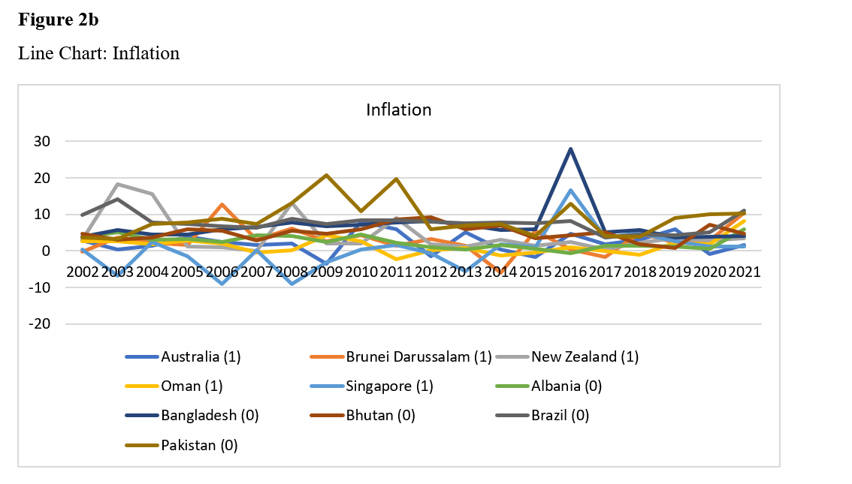
Descriptive : Inflation (2002-2021)

Slide 21
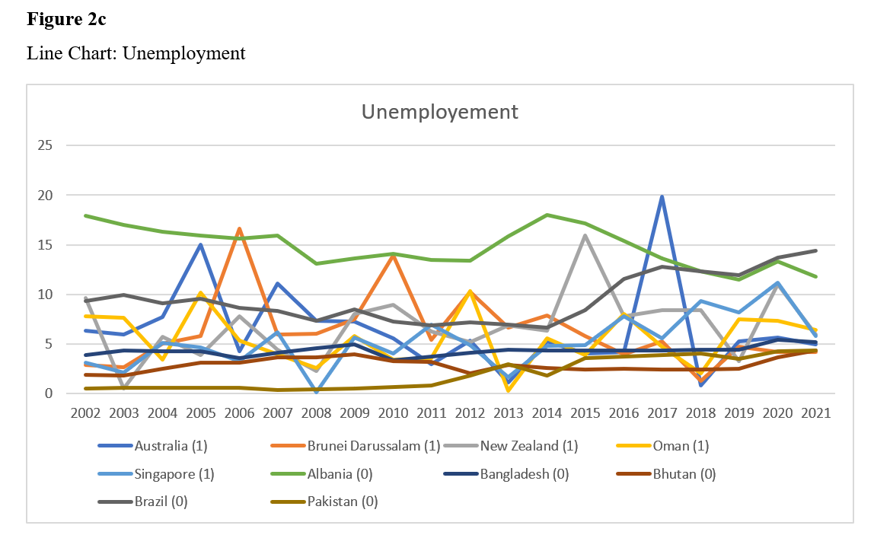
Descriptive : Unemployment (2002-2021)

Slide 22
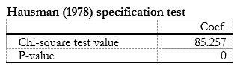


Hausman Test
Hausman Hypothesis:
H_{o}: No Differences in coefficients
H₁: Significant Differences in coefficients
Overall
Developed
Developing
Notes:
It basically tests whether the unique errors (ui) are correlated with the regressors; the null hypothesis is they are not.

Slide 23
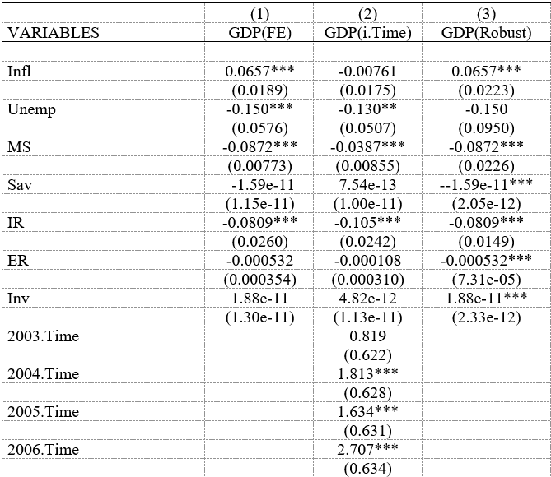
Regression (Overall)

Slide 24
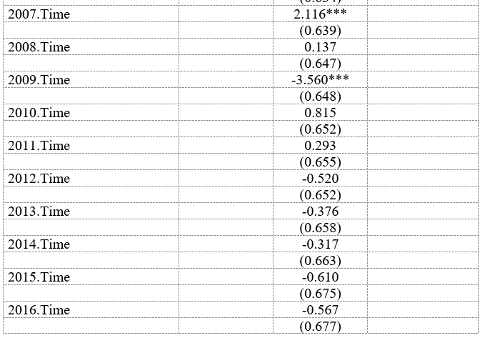
Regression (Overall)

Slide 25
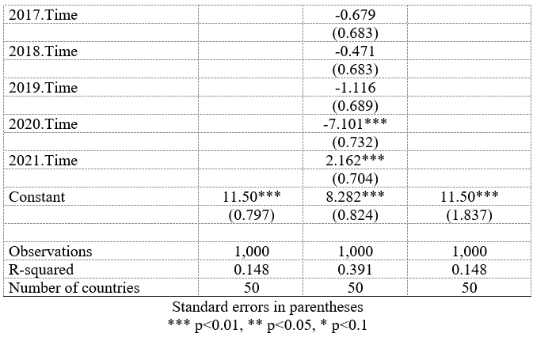
Regression (Overall)

Slide 26
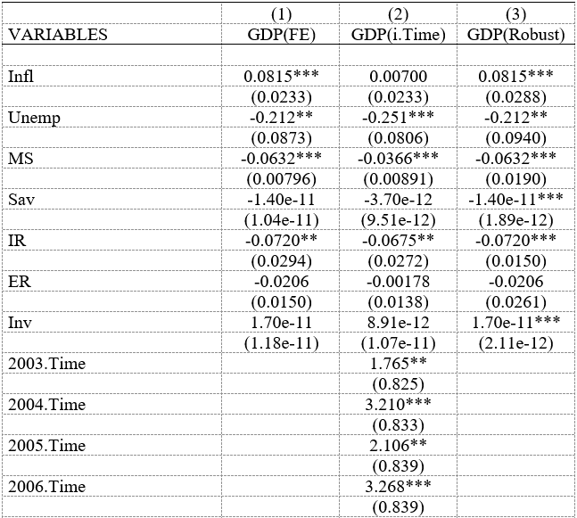
Regression (Developed)

Slide 27
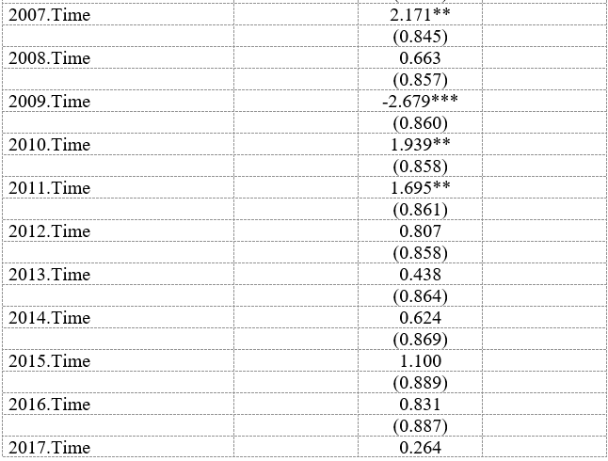
Regression (Developed)

Slide 28
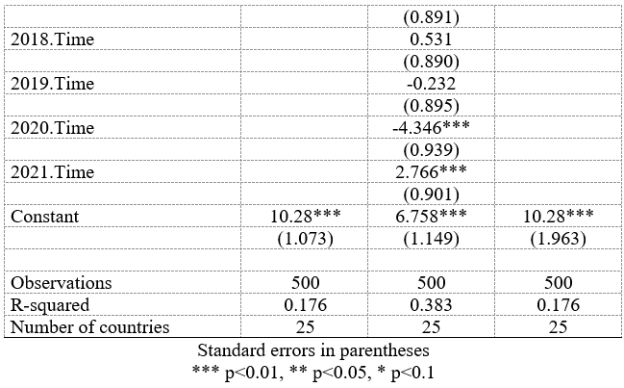
Regression (Developed)

Slide 29
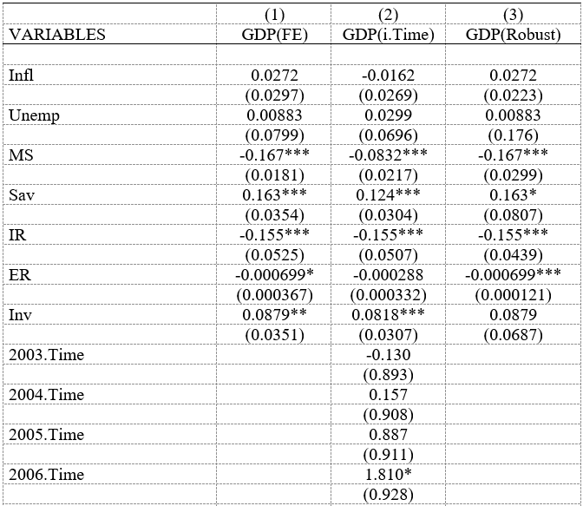
Regression (Developing)

Slide 30
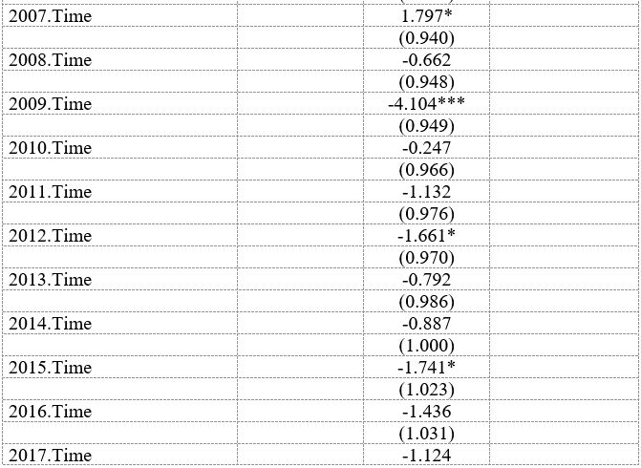
Regression (Developing)

Slide 31
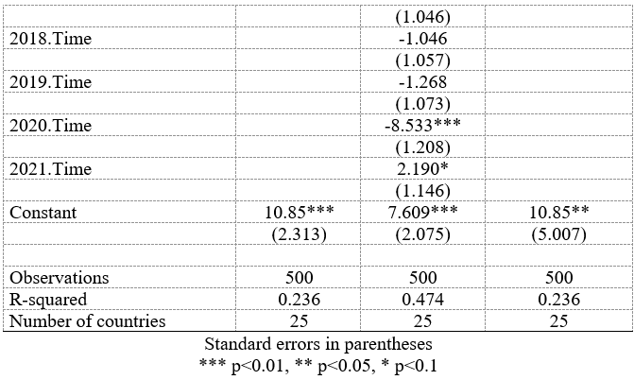
Regression (Developing)

Slide 32
Policy Recommendations
Create more job opportunities and stimulate economic activity. These efforts will lead to a reduction in unemployment and prices of commodities, ultimately improving the overall economy.
Inflation needs to be tackled differently for developed and developing countries according to the results in this research.
For developed countries a combination of monetary and fiscal policies can be used to induce economic growth .
For developing countries need to focus on development and factors such as Savings Rate, Interest Rate and Exchange Rate management.

Slide 33
Policy Recommendations
For Developing countries, policy makers should find a golden balance between inflation and economic growth as poverty levels may increase sharply if higher inflation is set as a target.
The policies and level of intervention would differ from country to country, therefore tailoring and structural reforms are needed that suits a particular economy.
Developing countries, they should diversify their dependance on many sectors rather than focusing on just one or two. This would also allow them some cushion from external shocks.

Slide 34
Implications
It would have been better to include more countries over a more extended period of time and with a larger number of observations to provide better results.
Although including more years would increase the number of observations and make the results more accurate but there may be presence of short-term relations, therefore shorter time period regressions may also yield better results.
More variable could be added to increase the degree for which the variables explain the changes in the GDP Growth (i.e., R²). Variable such as education, infrastructure, Corruption, level of technology etc.
Future studies should use instrumental variables to improve accuracy, and they should include additional independent variables to obtain more accurate results.
A stratified approach in classifying countries according to region, income levels, development levels (such as under developed countries, emerging economies etc.) could also depict the results in a better manner.

Slide 35
Conclusion
We found that there was a significant positive relationship between inflation and economic growth, which indicates that countries with higher inflation rates tended to have higher economic growth rates. This is consistent with previous research that has found a positive relationship between inflation and economic growth (Bleaney and Nishiyama, 2002).
There was a significant negative relationship between unemployment and economic growth, which suggests that countries with higher unemployment rates tended to have lower economic growth rates. This is consistent with previous research that has found a negative relationship between unemployment and economic growth (Aghion et al., 2005).
Different variables held significance incase of developed countries and developing countries.
The magnitude for variables in both divisions show a very different picture.
External factors such as political in stability, natural disasters may be the reason behind them/

Slide 36
References
Abu, A. (2017). The Impact of GDP on Unemployment in Nigeria: An Empirical Analysis. International Journal of Economics, Commerce and Management
Aghion, Ph., Howitt P. (1993), Growth and Unemployment, Review of Economic Studies,
Ajayi, R. O., & Ojo, M. O. (1979). Money supply and economic growth in Nigeria. Central Bank of Nigeria Economic and Financial Review
Ali, T. M., Mahmood, M. T., & Bashir, T. (2015). Impact of interest rate, inflation and money supply on exchange rate volatility in Pakistan. World Applied Sciences Journal, 33(4), 620-630
Aminu, U. and A.Z. Anono, 2012, 'An empirical Analysis of The Relationship between Unemployment and Inflation in Nigeria from 1977- 2009', Business Journal, Economics and Review
Amonoo, E (2003). The impact of interst rates on demand for credit loan repayment by the poor and SME`s in Ghana. International Labour Organanization
Angeriz, A., & Arestis, P. (2007). Inflation targeting in developing countries. Journal of Post Keynesian Economics
Angeriz, A., Arestis, P., 2007. Assessing the performance of ‘Inflation Targeting Lite’ countries
Anyanwu, J. C. and Oaikhenan, H. E. (1995), Modern Macroeconomics: Theory and Applications in Nigeria. Joanee Educational Publishers Limited, Onitsha, Nigeria.
Azam, M. (2020). The Impact of Inflation on Economic Growth: A Study of Pakistan. Journal of Economic and Social Development,

Slide 37
References
Azid T, Jamil M and Kousar A (2005), “Impact of Exchange Rate Volatility on Growth and Economic Performance: A Case Study of Pakistan, 1973-2003”, The Pakistan Development Review, Part II, Vol. 44, No. 4, pp. 749-775.
Balami, D. H. (2006). Macroeconomic theory and practice. Salawe prints, Off Leventies
Balami, D.H., 2006, Macroeconomic Theory and Practice, Salawe prints, Off Leventies, Wulari, Maiduguri.
Blanchard, O., & Kiyotaki, N. (1987). Monopolistic competition and the effects of aggregate demand. American Economic Review
Cárdenas, M., & Escobar, L. (1998). The relationship between savings and economic growth in developing countries. Journal of Development Economics
Cashell, B (2006) Economic Growth, Inflation and Unemployment: Limits to Economic Policy CRS Report for Congress
Cutler, M and L. Katz (1990) ‘Macroeconomic Performance and the Disadvantaged’ Brookings Papers on Economic Activity
Dornbusch, R., S. Fischer and C. Kearney. (1996). Macroeconomics. The Mc-Graw-Hill Companies
Duesenberry, J.S. (1949) Income, Saving, and the Theory of Consumer Behavior. Harvard University Press, Cambridge.

Slide 38
References
Edwards, S. (1996). Saving, growth, and the resource curse hypothesis. World Development
Emara, N., & Kasa, K. (2020). Inflation and savings in India: An empirical analysis. Journal of Asian Economics
ERÇEL, GAZİ(1999) “Türkiye’de Enflasyon ve Büyüme İlişkisi: Genel Bir Değerlendirme
Faridi, M. Z., & Kausar, R. (2016). Exploring the Existence of J-Curve in Pakistan: An Empirical Analysis. Pakistan Journal of Social Sciences (PJSS), 36(1).
Fatukasi, B. (2011). Determinant of Inflation in Nigeria: An Empirical Analysis, International Journal of Humanities and Social Sciences
FISCHER, S., (1991) Growth, macroeconomics and development.
Friedman, A. (1968). The Stefan problem in several space variables. Transactions of the American Mathematical Society, 133(1), 51-87.
Friedman, M. (1976). Inflation and Unemployment. Chicago Journals - Journal of Political Economy , 451 - 472.
Garidzira, T. (2020). The relationship between unemployment and economic growth: Evidence from Zimbabwe. Journal of Economics and International Finance

Slide 39
References
Emara, N., & Kasa, K. (2020). Inflation and savings in India: An empirical analysis. Journal of Asian Economics
ERÇEL, GAZİ(1999) “Türkiye’de Enflasyon ve Büyüme İlişkisi: Genel Bir Değerlendirme
Faridi, M. Z., & Kausar, R. (2016). Exploring the Existence of J-Curve in Pakistan: An Empirical Analysis. Pakistan Journal of Social Sciences (PJSS), 36(1).
Fatukasi, B. (2011). Determinant of Inflation in Nigeria: An Empirical Analysis, International Journal of Humanities and Social Sciences
FISCHER, S., (1991) Growth, macroeconomics and development.
Friedman, A. (1968). The Stefan problem in several space variables. Transactions of the American Mathematical Society, 133(1), 51-87.
Friedman, M. (1976). Inflation and Unemployment. Chicago Journals - Journal of Political Economy , 451 - 472.
Garidzira, T. (2020). The relationship between unemployment and economic growth: Evidence from Zimbabwe. Journal of Economics and International Finance
Gokal V and Hanif S. (2004) “Relationship between Inflation and Economic Growth” Working Paper, Economics Department
Grossman, H. J. (1981). Money supply and interest rates: A survey of the evidence. The Journal of Economic Literature

Slide 40
References
Guegnard, C., X. Matheu and M. Shteiwi, 2005. Unemployment in Jordan. 1st Edn., Office for Official Publications of the European Communities, Luxembourg
Gultekin, N. (1983). Stock Market Returns and Inflation: Evidence from Other Countries.
Hameed, A., & Kanwal, S. (2009). Existence of a J-Curve-The Case of Pakistan. Journal of Economic Cooperation & Development, 30(2).
Hassan, M. (2005). Monetary Aggregates in Pakistan: Theoretical and Empirical Underpinnings. State Bank of Pakistan.
Himarios, D. (1989). Do devaluations improve the trade balance? The evidence revisited. Economic inquiry, 27(1), 143-168.
Hussain T, Siddiqi MW, Iqbal A. A coherent relationship between economic growth and unemployment: An empirical evidence from Pakistan. International Journal of Human and Social Sciences. 2010
ILO, 2009, International Labour Organization, Labour Statistics Yearbook, Geneva
Jhingan, M. L., 2003, Advanced Macroeconomic Theory 11h Edition. Delhi: Vrinda Publications
Kara, M. ve M. Duruel (2005). Türkiye’de Ekonominin İstihdam Yaratamama Sorunu, İ.Ü. İktisat Fakültesi Sosyal Siyaset Konferansları 50. Kitap, (Prof. Dr. Nevzat Yalçıntaş’a Armağan – Özel Sayı), İstanbul, ss. 367-396.
Karahan, F. (2020). Inflation and economic growth: A survey of the literature. Journal of Economic Surveys

Slide 41
References
Khan, A. H., L. Hasan, and A. Malik (1994), Determinants of National Savings Rate in Pakistan, Economia Internazionale
Krieckhaus, J. (2002). Saving and economic growth: A comparative analysis. Journal of Comparative Economics
Krukovi, D. (2020). Monetary policy and exchange rate regimes: Evidence from the new EU member states. Journal of Policy Modeling
Levišauskait, K. (2010). Investment Analysis and Portfolio Management
Lima, P. (2020). Economic growth and unemployment: A literature review. Journal of Economic Surveys
Lyuboslav Kostov. 2016. The impact of economic growth on inflation and unemployment in Bulgaria. Journal for Labour and Social Affairs in Eastern Europe
Mallik, G. and Chowdhury, A. (2001). Inflation and Economic Growth: Evidence from South Asian Countries. Asian Pacific Development Journal
Max Roser (2013) - "Economic Growth". Published online at OurWorldInData.org. Retrieved from: 'https://ourworldindata.org/economic-growth' [Online Resource]
McConnell, C. R., & Brue, S. L. (2008). Economics: Principles, problems, and policies (18th ed.). McGraw-Hill.

Slide 42
References
Miller, R. L., & Benjamin, D. K. (2008). The Economics of Macro Issues. Pearson Addison Wesley.
Motley, B. (1994). Economic growth and saving: An international comparison. Journal of International Economics
Mudell. 1963. Economic Growth and Inflation. Research Journal of Finance and Accounting
Muritala. 2011. Economic Growth and Inflation. Research Journal of Finance and Accounting
Obadan, M. I. (1997), Analytical framework for poverty reduction: Issues of economic growth versus other strategies. In: Poverty Alleviation in Nigeria, Selected Papers for the 1997 Annual Conference of Nigerian Economic Society
Okun, A. (1962). Potential GNP: Its measurement and significance. Proceedings of the Business and Economic Statistics Section, American Statistical Association
Orji, A., Orji-Anthony, I., & Okafor, J. (2015). Inflation and Unemployment Nexus in Nigeria: Another test of the Phillip's Curve. . Asian Economic and Financial Review.
Page, J. (1994). Saving and economic growth. Journal of Economic Growth
Pasara, R. (2020). Unemployment, Gross Capital Accumulation, and Economic Development. Journal of Economics, Business and Management
Phillips, A. W. (1958). The Relationship between Unemployment and the Rate of Change of Money Wage in the United Kingdom

Slide 43
References
Prachowny, M. (1993). The Political Economy of Public Finance in Britain, 1767-1873. Routledge
Rasheed, A., & et al. (1997). Inflation and its impact on the economy. Journal of Economic Studies
Rashid, A. and Kernal, A. (1997). Macroeconomic Policies and their Impact on Poverty alleviation in Pakistan. The Pakistan Development Review, vol.36 (no.1), pp.39-68.
Roley, V. V. (1981). The impact of money supply and interest rate changes on investment. Journal of Monetary Economics
Romer, D. Advanced Macroeconomics. New York: McGraw-Hill Irvin, 2006.
Sargan, J. D., & Bhargava, A. (1983). Testing residuals from least squares regression for being generated by the Gaussian random walk. Econometrica: Journal of the Econometric Society, 153-174.
Schmitz, J. (2007). Industrial policy in developing countries: A review of the evidence. World Development
Shahid, M. (2014). Effect of inflation and unemployment on economic growth in Pakistan. Journal of economics and sustainable development, 5(15), 103-106.
Shahid, M. (2014). Effects of inflation and unemployment on economic growth in Pakistan'. Journal of economics and sustainable development
Sidrauski, M. 1967. Inflation and Economic Growth. The Journal of Political Economy
Solow, R. M., & Swan, T. W. (1956). A contribution to the theory of economic growth. The Quarterly Journal of Economics
Soylu, S., & Soylu, F., & Gokmenoglu, K. (2018). The Relationship Between GDP and Unemployment: Evidence from the OECD Countries. International Journal of Economics, Commerce and Management

Slide 44
References
Stephen G. (2012), “Reassessing the impact of finance on growth”, Bank for International Settlements working paper
Summa, R. (2012). Inflation targeting and exchange rate regimes. Journal of International Economics
Taiwo, M. (2011). Investment, Inflation and Economic Growth”: Empirical Evidence from Nigeria. Research Journal of Finance and Accounting
Ting, L., & Ling, S. (2011). The relationship between GDP growth and unemployment: Evidence from the G-7 countries. International Journal of Economics, Commerce and Management
Tiwari, Rajanish. (2003). Post – Crisis exchange rates regimes in Southeast Asia: an empirical survey of the facto policies. University of Hamburg.
Tobin, J. (1965) .Money and Economic Growth. Econometrica
Udemba, C. (2020). The role of foreign direct investment in China's economic development: Evidence from the manufacturing sector. Journal of Asian Economics
Ullah, R and M. Umair, M (2013) ‘Impact of GDP and Inflation on Unemployment Rate: A Study of Pakistan Economy in 2000-2010

Slide 45
References
Umaru, A., & Zubairu, A. (2012). An Empirical Analysis of the Relationship between Unemployment and inflation in Nigeria from 1977-2009. Economics and Finance Review Vol.1.
Urich, J., & Wachtel, P. (1981). Money supply and interest rate: A test of the monetary transmission mechanism. The Journal of Finance
Urich, T. "The Informational Content of Weekly Money Supply Annoncerets.Journal of Monetary Economics, 1O(l98).
Walsh, C. E. (2003). Monetary theory and policy (2nd ed.). MIT Press.
Yao, Shujie, Zhang, Zhongyi, 2003. Openness and economic performance, a comparative study of China and the East Asian newly industrialized economies. Journal of Chinese Economic Business Studies

Slide 46
THANK YOU!

